Slide 1


Domestic Violence During COVID-19 Pandemic
Grant Savage
Data 512

Slide 2



Scope of Domestic Violence in the United States
Domestic Violence accounts for 21% of all violent victimizations
1 in 5
women
1 in 7
men
&
Report having experienced severe physical violence from an intimate partner in their lifetime.

Slide 3
Cost of Domestic Violence in the United States
The estimated lifetime cost associated with medical services, lost productivity from paid work, criminal justice and other costs related to intimate partner violence (IPV) is $3.6 trillion.

Slide 4
The Covid-19 Pandemic Intensifies Conditions that Fuel Domestic Violence
Time spent at home has increased 28%
“Besides the quarantine situation, the pandemic also aggravated alcohol abuse, depression and post-traumatic stress disorder. All of these factors created an environment that exacerbates domestic violence.” – Sumayah Abed, M.D.
Dept. of Family & Community Medicine,
University of Alabama
28%
35%
Time spent with people outside the household fell 35%

Slide 5

The Impact of COVID-19 on Domestic Violence is Important to Understand
Officials need to understand the impact so they can properly fund programs such as The National Domestic Violence Hotline and The National Center for Victims of Crime as well as the countless state and local programs.
Non-profits can use the data in funding outreach and to develop new strategies to prevent domestic violence.
In May 2020, at the peak of unemployment, 49.8m Americans were out of a job due to COVID-19, why add more due to domestic violence

Slide 6
Scope of Analysis
How was the rate of reported domestic violence cases influenced by the pandemic?
Is there a month/season where the reported cases peaked?
Have domestic violence cases dropped since the vaccine became available?

Slide 7
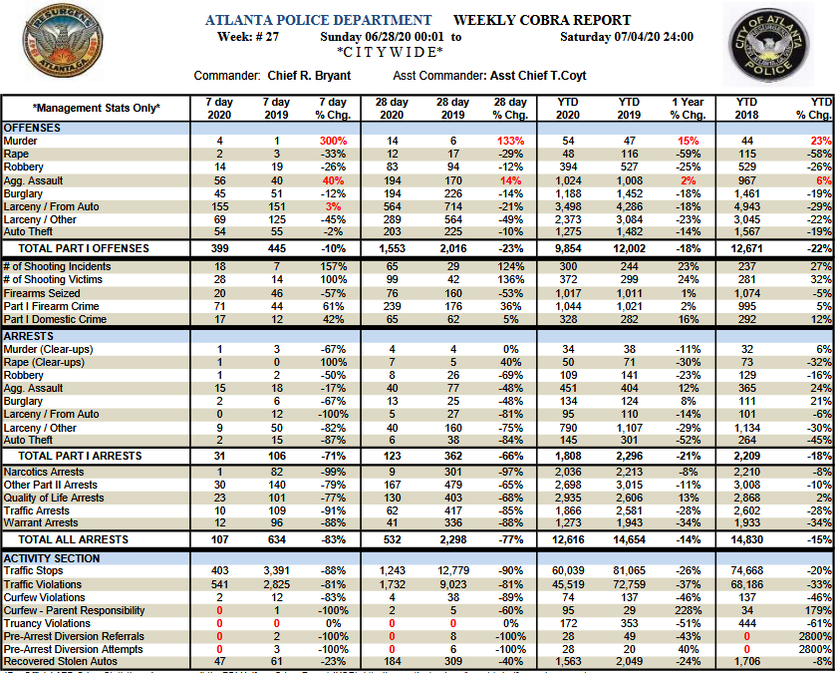
Limitations of Data
APD releases weekly summary data which includes a count of Domestic Violence cases.
There is no documentation on the methodology for gathering this data and the quality can not be verified.

Slide 8
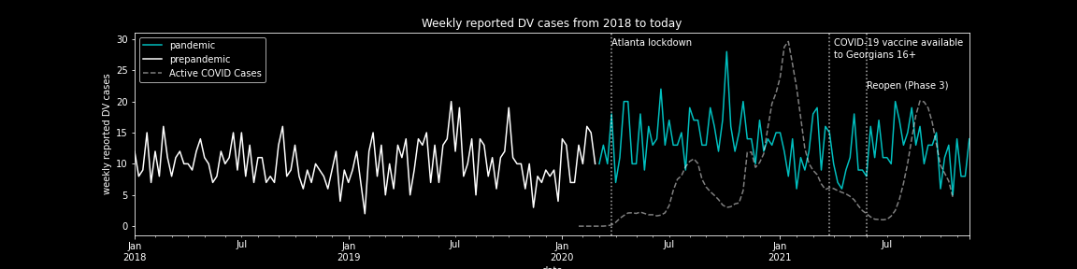
Impacts of COVID on Domestic Violence Rates
+29% increase in reported cases*
*Welch t-test proves significance

Slide 9
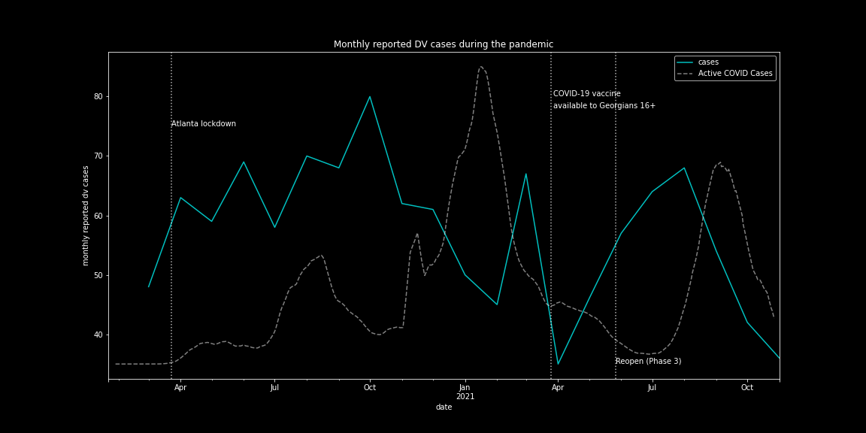
Peak Domestic Violence Rates
The peak month was October, 2020 with 80 reported cases of Domestic Violence.
No seasonal trends were detected in the data
Casual observance shows spikes in reported DV cases after initial COVID case rise in July, when many may have started isolating at home. It would be interesting to see if case spikes correlate with social distancing & isolating at home practices.

Slide 10
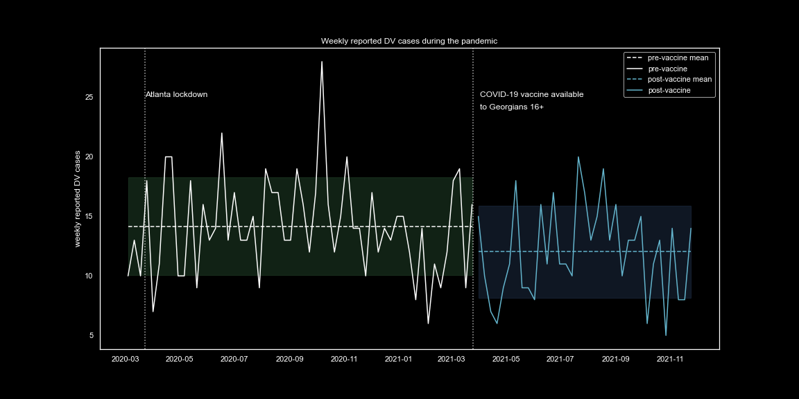
Impact of the Vaccine on Domestic Violence
The lower mean is promising, but t-tests and change detection methods (which did detected the beginning of the pandemic) do not show significance.
At this time we can not claim the vaccine is lowering the cases of reported domestic violence.

Slide 11
Next Steps
Acquire data that represent different signals for time spent at home (such as SafeGraph) and include it in the analysis
Acquire and incorporate timeseries data for job loss and include it in the analysis
Conduct similar review on a more granular data source (Chicago’s data portal provides much more granular incident data)
Use more sophisticated modeling techniques with additional signals

Slide 12
Services and Hotlines
National Domestic Violence Hotline: https://www.thehotline.org/
UW’s LiveWell Confidential Advocates: https://livewell.uw.edu/survivor-support-advocacy/
Lifewire: https://www.lifewire.org/
Many more resources on UW’s Police page.

